Slide 1
Online E-Book Store
Features:-
New user account registration
Admin Login
User login
Book search (by author name, title, category)
Payment Option
shopping cart
Add/delete books from shopping cart
Place the order
Order trace

Slide 2
List book information title, author, price and quantity-in-stock of some chosen books
List information about those orders assigned to him/her
Update order status
User Can also sell old books.
Insert new books
Compatible for all Devices.

Slide 3
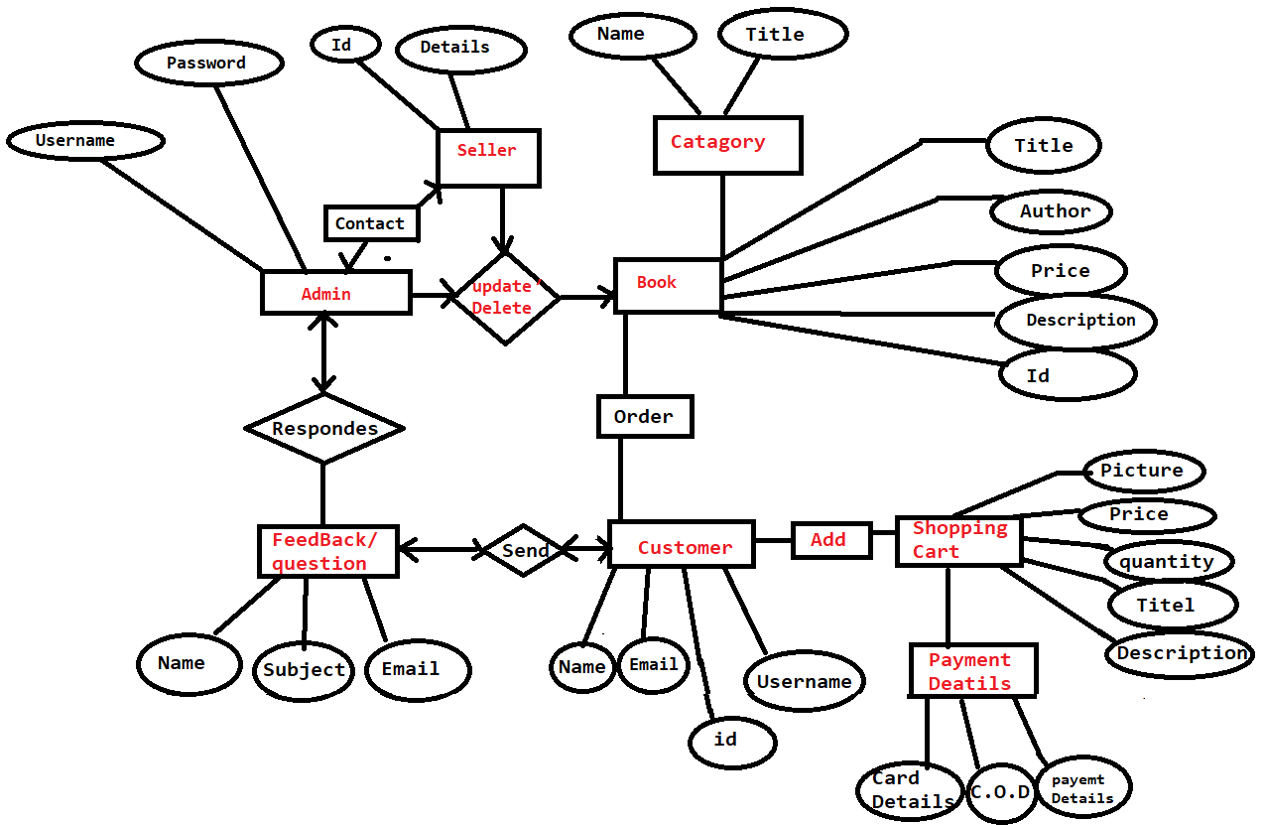
ER-Diagram:-
ER-Diagram

Slide 4
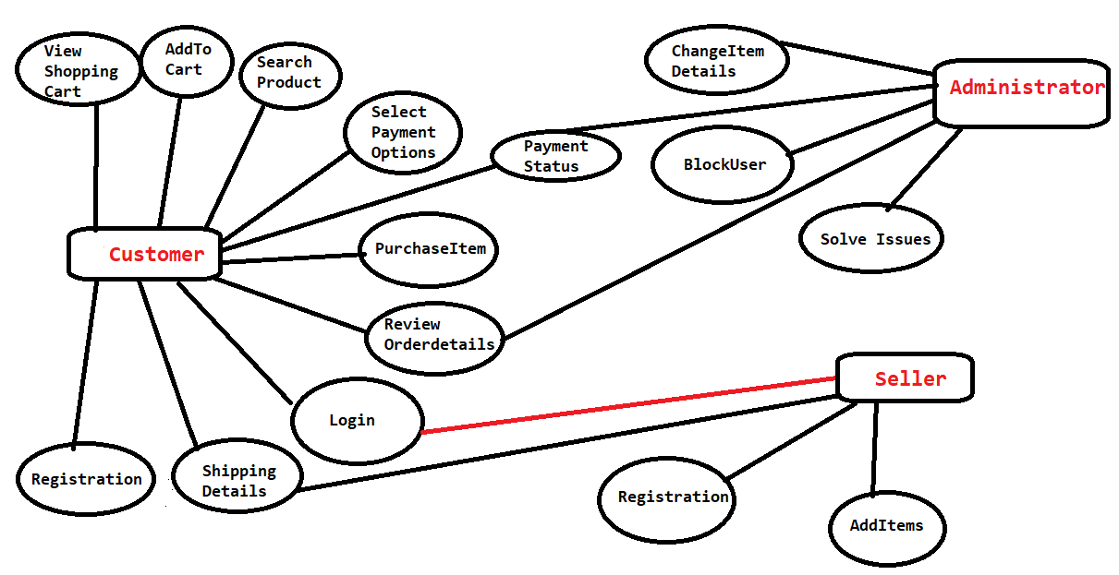
Use Case Diagram:-

Slide 5
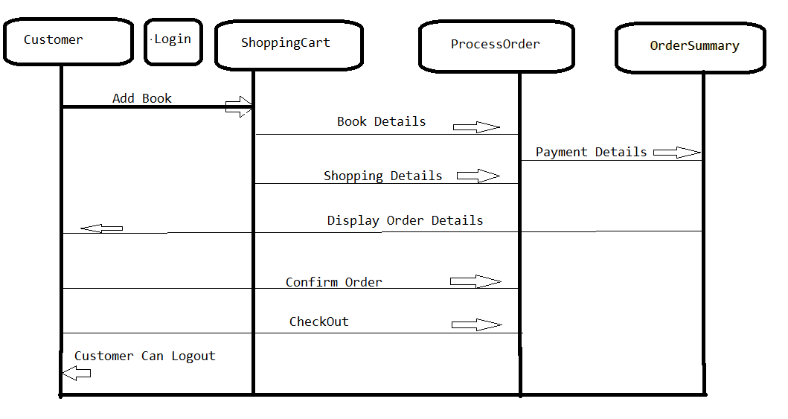
Activity Diagram:-

Slide 6
Project Modules:-
Account.
Shipping Management
Book Management
Payments
Help
Contact us

Slide 7
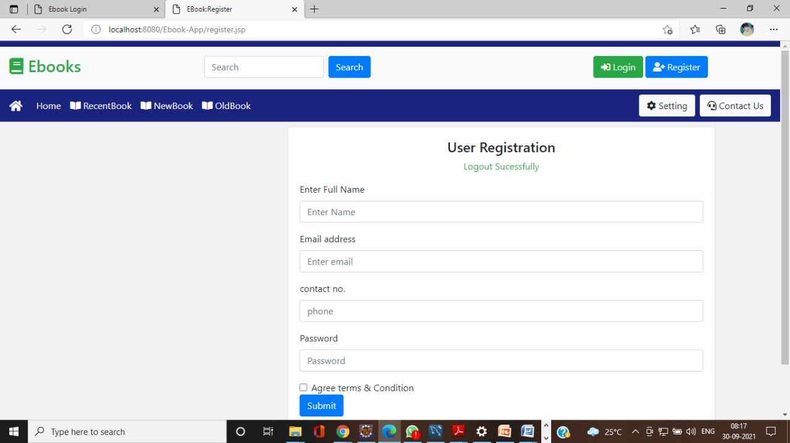
Register
The register module contains the application form or registration form which contains following details. Name, Address, Contact number, E-mail id, Password etc.
Name, Address, Contact number, E-mail id, Password etc.

Slide 8
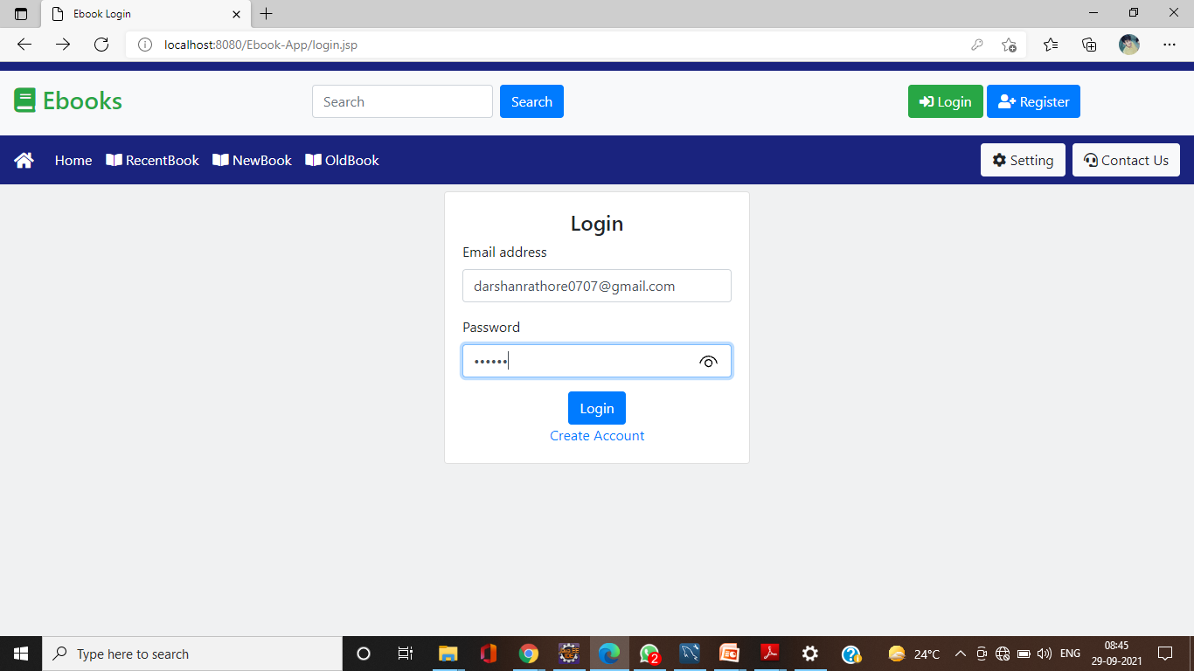
Login
The Login module contain the form which contain membership name and member password. It includes Username and Password

Slide 9
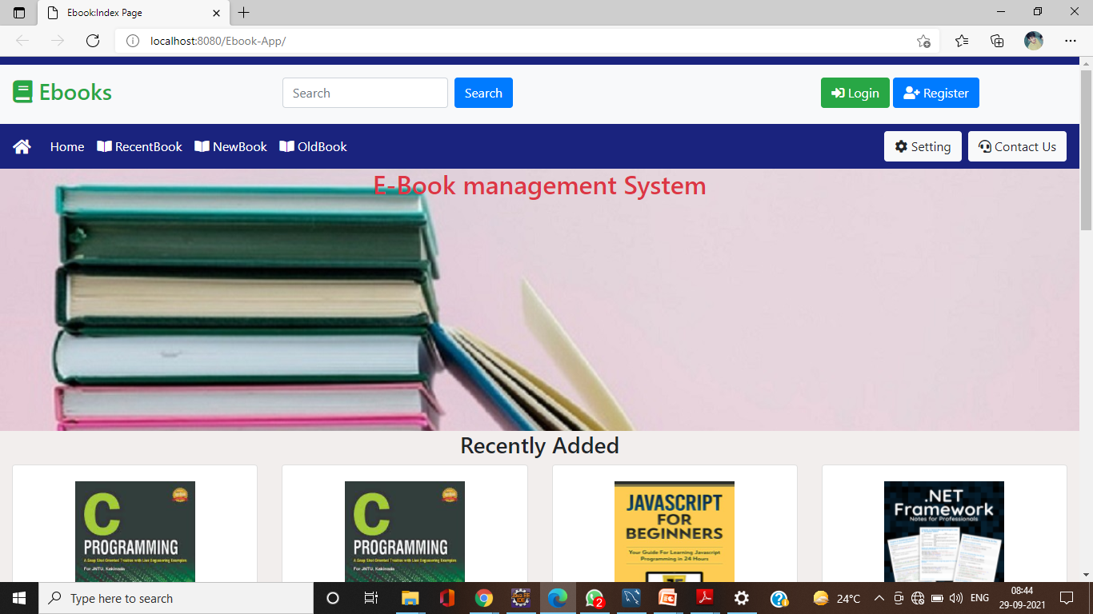
Home Page
The Home Page Module contains the navigation bar and important information of the website with books to browse.

Slide 10
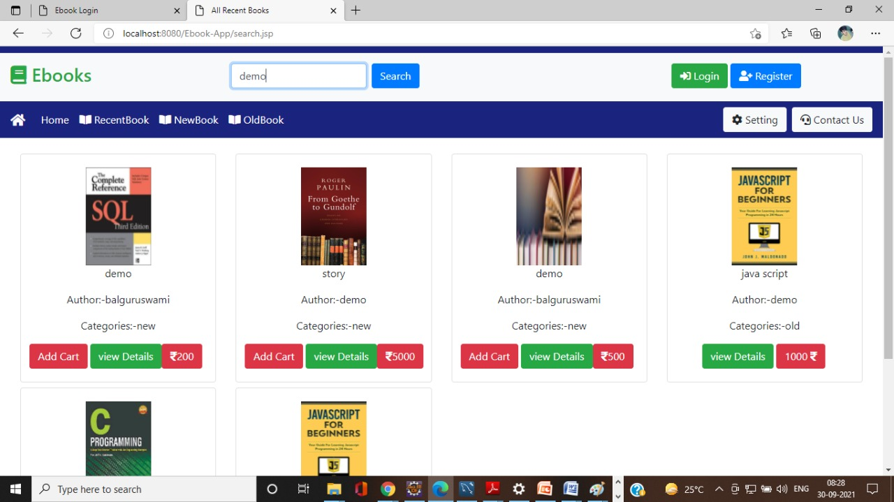
Search Books
The search book module contains list of books, from this list we search for the book which we need

Slide 11
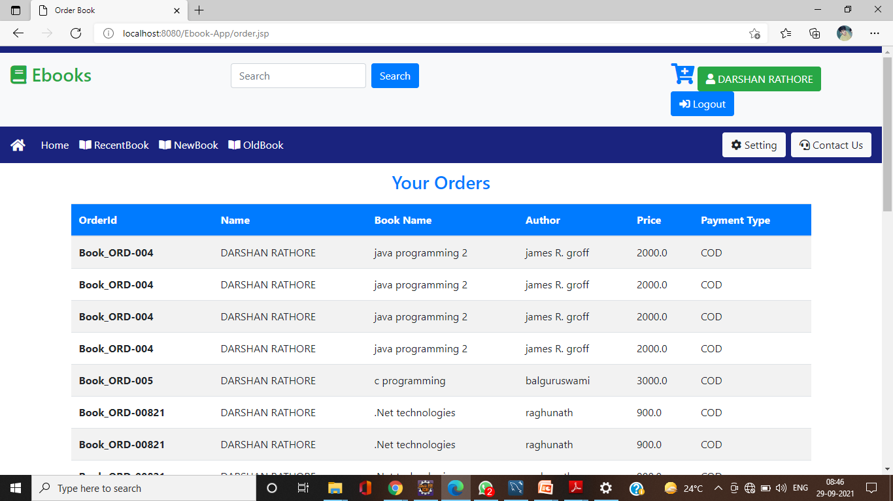
Order
The Order Module contains the list of books in the cart with their Title, Author Name, Price, Quantity respectively.

Slide 12
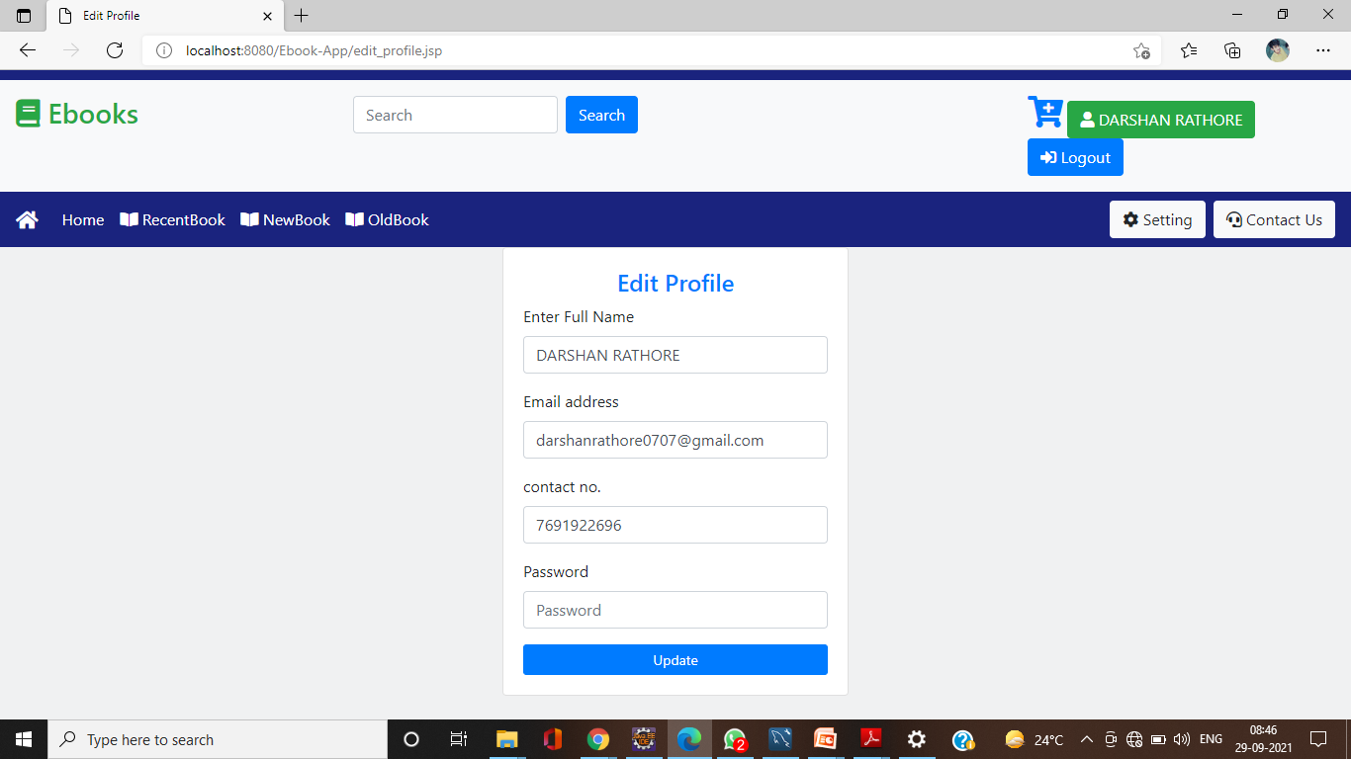
Update
The update module should be maintained by the website administrator. The admin should update each and every process like.

Slide 13
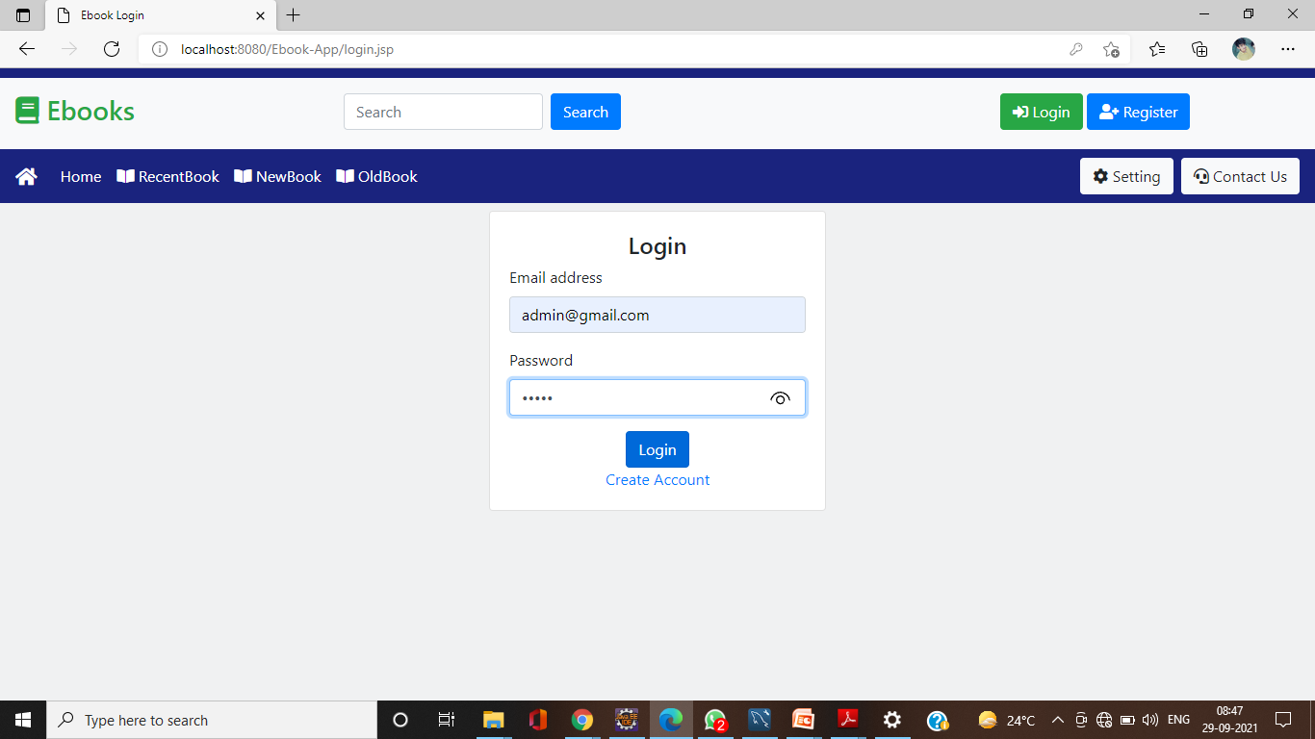
Admin Profile
The Admin Module Consist of all the Backend functionalities required to provide stocks of the books with full control of
the flow of the application related to sales and delivery system.

Slide 14
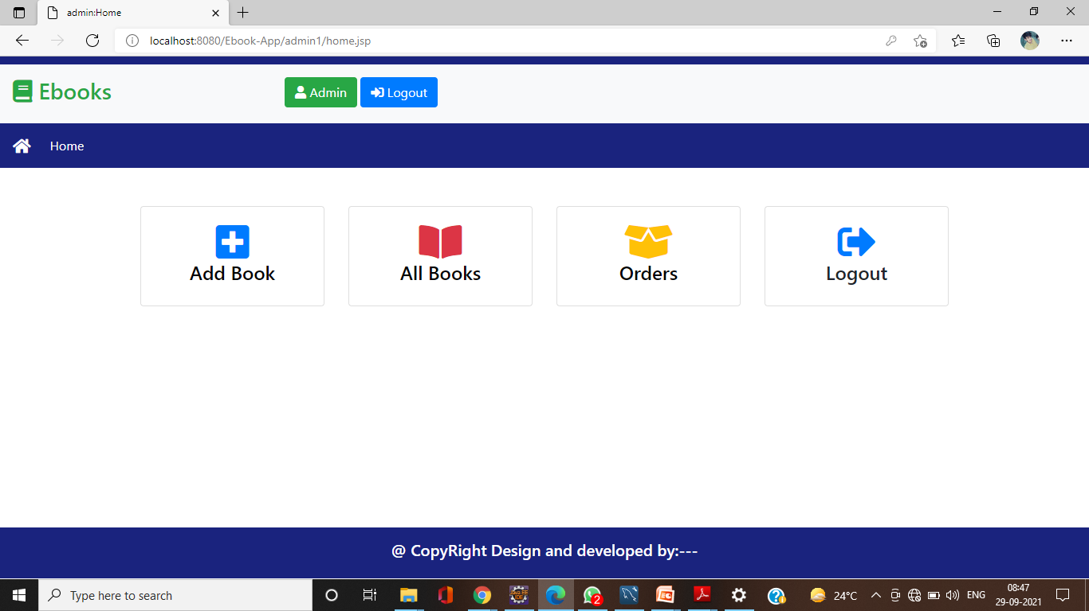

Slide 15
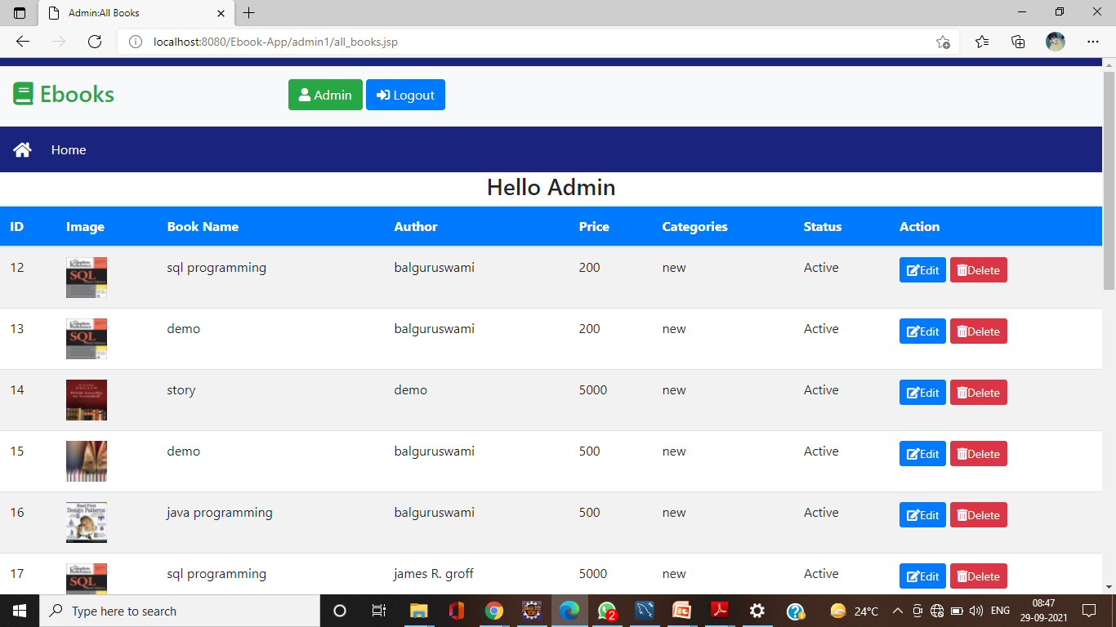

Slide 16
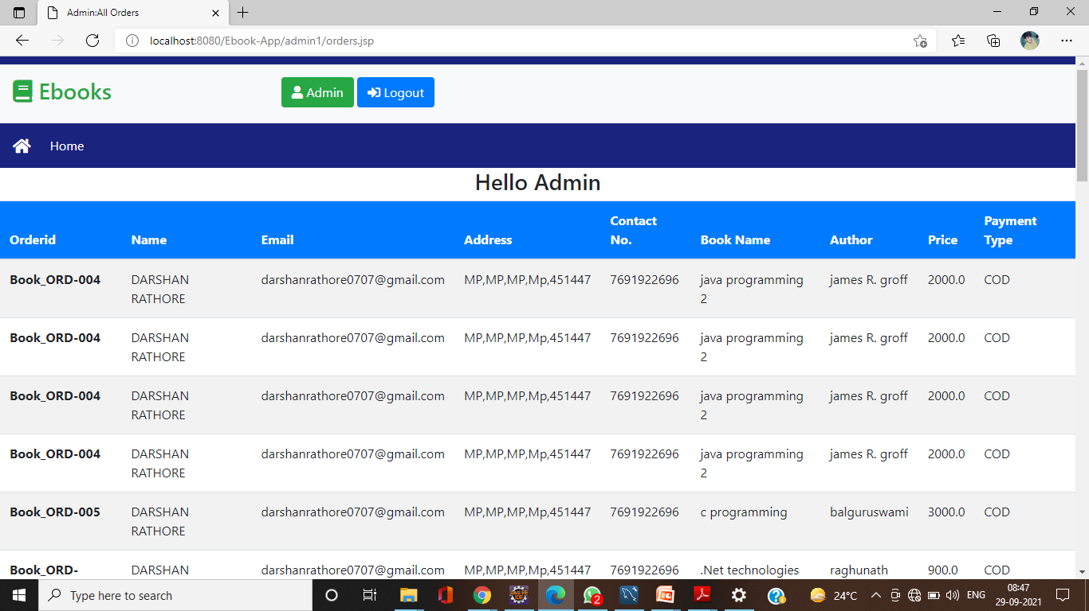

Slide 17
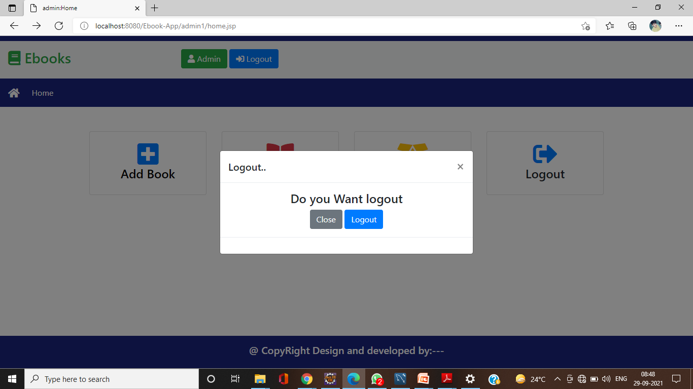

Slide 18
Components:-
user registration
seller processing
Administration.
home page.
Registration/login form.
search/order/payment
data Base Access

Slide 19
TECHNOLOGIES TO BE USED :-
HTML - Markup Language used for creating web pages.
J2EE - Java 2 Enterprise Edition is a programming platform and it is the part of the java platform for developing and running distributed java applications.
HTTP -Hyper Text Transfer Protocol
TCP/IP - Transmission Control Protocol/Internet Protocol is the communication protocol used to connect hosts on the Internet
BootStrap,Css,servlet and Jsp.

